Slide 1
Foundations of Machine Learning
Module 6: Neural Network
Part B: Multi-layer Neural Network
Sudeshna Sarkar
IIT Kharagpur

Slide 2
Limitations of Perceptrons
Perceptrons have a monotinicity property:
If a link has positive weight, activation can only increase as the corresponding input value increases (irrespective of other input values)
Can’t represent functions where input interactions can cancel one another’s effect (e.g. XOR)
Can represent only linearly separable functions

Slide 3
A solution: multiple layers
output layer
y
y
z₂
hidden layer
z₁
z₂
z₁
x₂
input layer
x₁
x₂
x₁

Slide 4
Power/Expressiveness of Multilayer Networks
Can represent interactions among inputs
Two layer networks can represent any Boolean function, and continuous functions (within a tolerance) as long as the number of hidden units is sufficient and appropriate activation functions used
Learning algorithms exist, but weaker guarantees than perceptron learning algorithms

Slide 5
Multilayer Network

Slide 6
Two-layer back-propagation neural network

Slide 7
The back-propagation training algorithm
Step 1: Initialisation Set all the weights and threshold levels of the network to random numbers uniformly distributed inside a small range

Slide 8
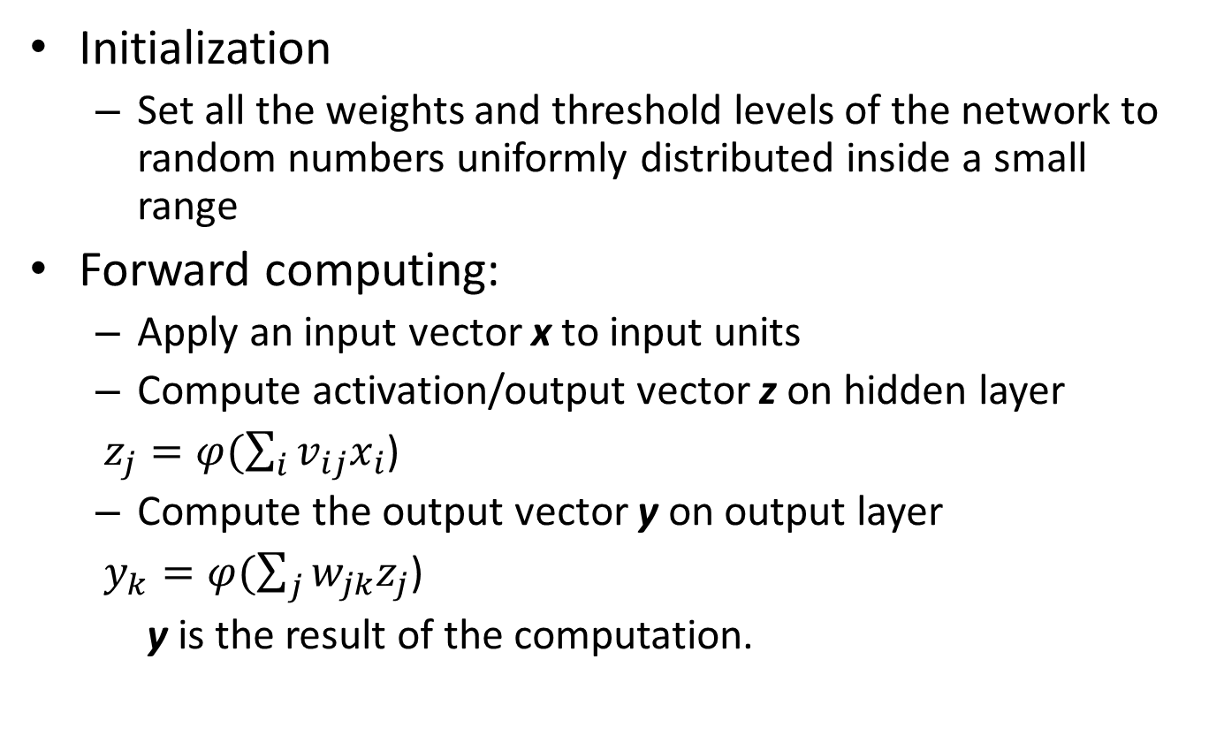
Backprop
Initialization
Set all the weights and threshold levels of the network to random numbers uniformly distributed inside a small range
Forward computing:
Apply an input vector x to input units
Compute activation/output vector z on hidden layer
$z_{j}=φ(\sum_{i}{v_{ij}x_{i}}$)
Compute the output vector y on output layer
$y_{k}=φ(\sum_{j}{w_{jk}z_{j}}$)
y is the result of the computation.

Slide 9
Learning for BP Nets
Update of weights in W (between output and hidden layers):
delta rule
Not applicable to updating V (between input and hidden)
don’t know the target values for hidden units z1, Z2, … ,ZP
Solution: Propagate errors at output units to hidden units to drive the update of weights in V (again by delta rule) (error BACKPROPAGATION learning)
Error backpropagation can be continued downward if the net has more than one hidden layer.
How to compute errors on hidden units?

Slide 10
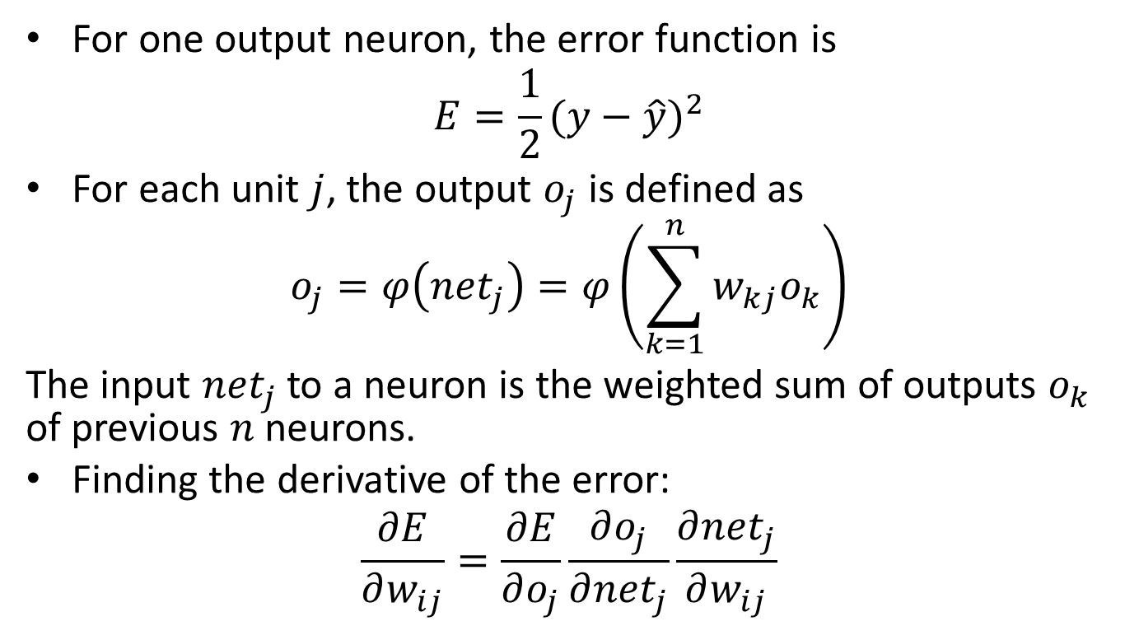
Derivation
For one output neuron, the error function is
$$E=\frac{1}{2}{(y−\hat{y})}^{2}$$
For each unit $j$, the output $o_{j}$ is defined as
$$o_{j}=φ\left({net}_{j}\right)=φ\left(\sum_{k=1}^{n}{w_{kj}o_{k}}\right)$$
The input ${net}_{j}$ to a neuron is the weighted sum of outputs $o_{k}$ of previous $n$ neurons.
Finding the derivative of the error:
$$\frac{∂E}{∂w_{ij}}=\frac{∂E}{∂o_{j}}\frac{∂o_{j}}{∂{net}_{j}}\frac{∂{net}_{j}}{∂w_{ij}}$$

Slide 11
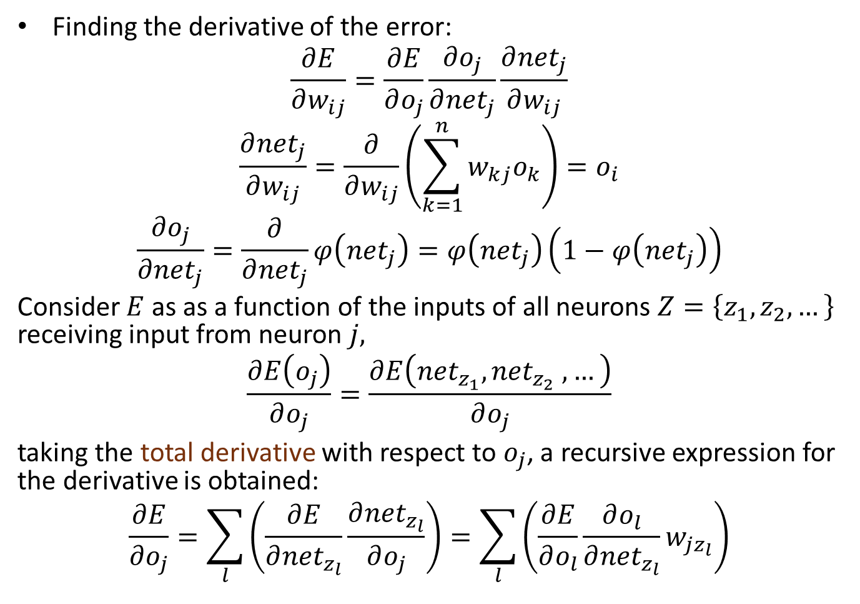
Derivation
Finding the derivative of the error:
$$\frac{∂E}{∂w_{ij}}=\frac{∂E}{∂o_{j}}\frac{∂o_{j}}{∂{net}_{j}}\frac{∂{net}_{j}}{∂w_{ij}}$$
$$\frac{∂{net}_{j}}{∂w_{ij}}=\frac{∂}{∂w_{ij}}\left(\sum_{k=1}^{n}{w_{kj}o_{k}}\right)=o_{i}$$
$$\frac{∂o_{j}}{∂{net}_{j}}=\frac{∂}{∂{net}_{j}}φ\left({net}_{j}\right)=φ\left({net}_{j}\right)\left(1−φ\left({net}_{j}\right)\right)$$
Consider $E$ as as a function of the inputs of all neurons $Z=\left\{z_{1},z_{2},…\right\}$ receiving input from neuron $j,$
$$\frac{∂E\left(o_{j}\right)}{∂o_{j}}=\frac{∂E\left({net}_{z_{1}},{net}_{z_{2}} ,…\right)}{∂o_{j}}$$
taking the total derivative with respect to $o_{j}$, a recursive expression for the derivative is obtained:
$$\frac{∂E}{∂o_{j}}=\sum_{l}{\left(\frac{∂E}{∂{net}_{z_{l}}}\frac{∂{net}_{z_{l}}}{∂o_{j}}\right)}=\sum_{l}{\left(\frac{∂E}{∂o_{l}}\frac{∂o_{l}}{∂{net}_{z_{l}}}w_{jz_{l}}\right)}$$

Slide 12
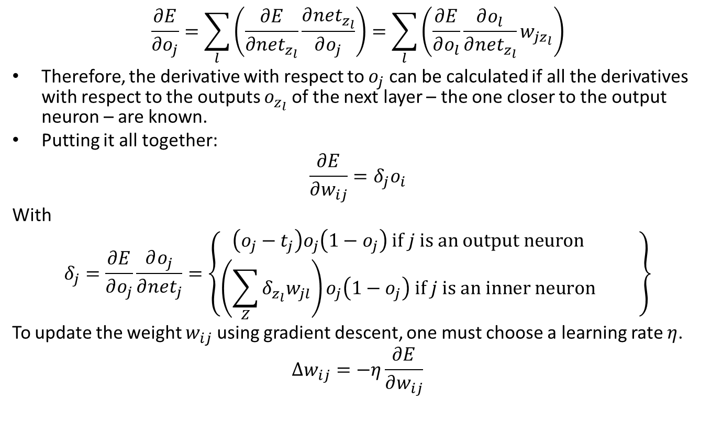
$$\frac{∂E}{∂o_{j}}=\sum_{l}{\left(\frac{∂E}{∂{net}_{z_{l}}}\frac{∂{net}_{z_{l}}}{∂o_{j}}\right)}=\sum_{l}{\left(\frac{∂E}{∂o_{l}}\frac{∂o_{l}}{∂{net}_{z_{l}}}w_{jz_{l}}\right)}$$
Therefore, the derivative with respect to $o_{j}$ can be calculated if all the derivatives with respect to the outputs $o_{z_{l}}$ of the next layer – the one closer to the output neuron – are known.
Putting it all together:
$$\frac{∂E}{∂w_{ij}}=δ_{j}o_{i}$$
With
$$δ_{j}=\frac{∂E}{∂o_{j}}\frac{∂o_{j}}{∂{net}_{j}}=\left\{\begin{matrix}\left(o_{j}−t_{j}\right)o_{j}\left(1−o_{j}\right) if j is an output neuron \\ \left(\sum_{Z}{δ_{z_{l}}w_{jl}}\right)o_{j}\left(1−o_{j}\right) if j is an inner neuron\end{matrix} \right\}$$
To update the weight $w_{ij}$ using gradient descent, one must choose a learning rate $η$.
$$∆w_{ij}=−η\frac{∂E}{∂w_{ij}}$$

Slide 13
Backpropagation Algorithm

Slide 14
Thank You

